Slide 1
Evaluation #3 - STEP/PEST
Assessment of external influences
  Allows businesses an insight into the obstacles in their market
  Narrows down the areas being focused on
Prioritizes four aspects
  Social
  Technological
  Economic
  Political

Slide 2
Evaluation #3 - STEP/PEST
Social
  Who your buyer is demographically
Technological
  Infrastructural challenges
Economic
  Knowing the performance of your market
Political
  Legislative barriers

Slide 3
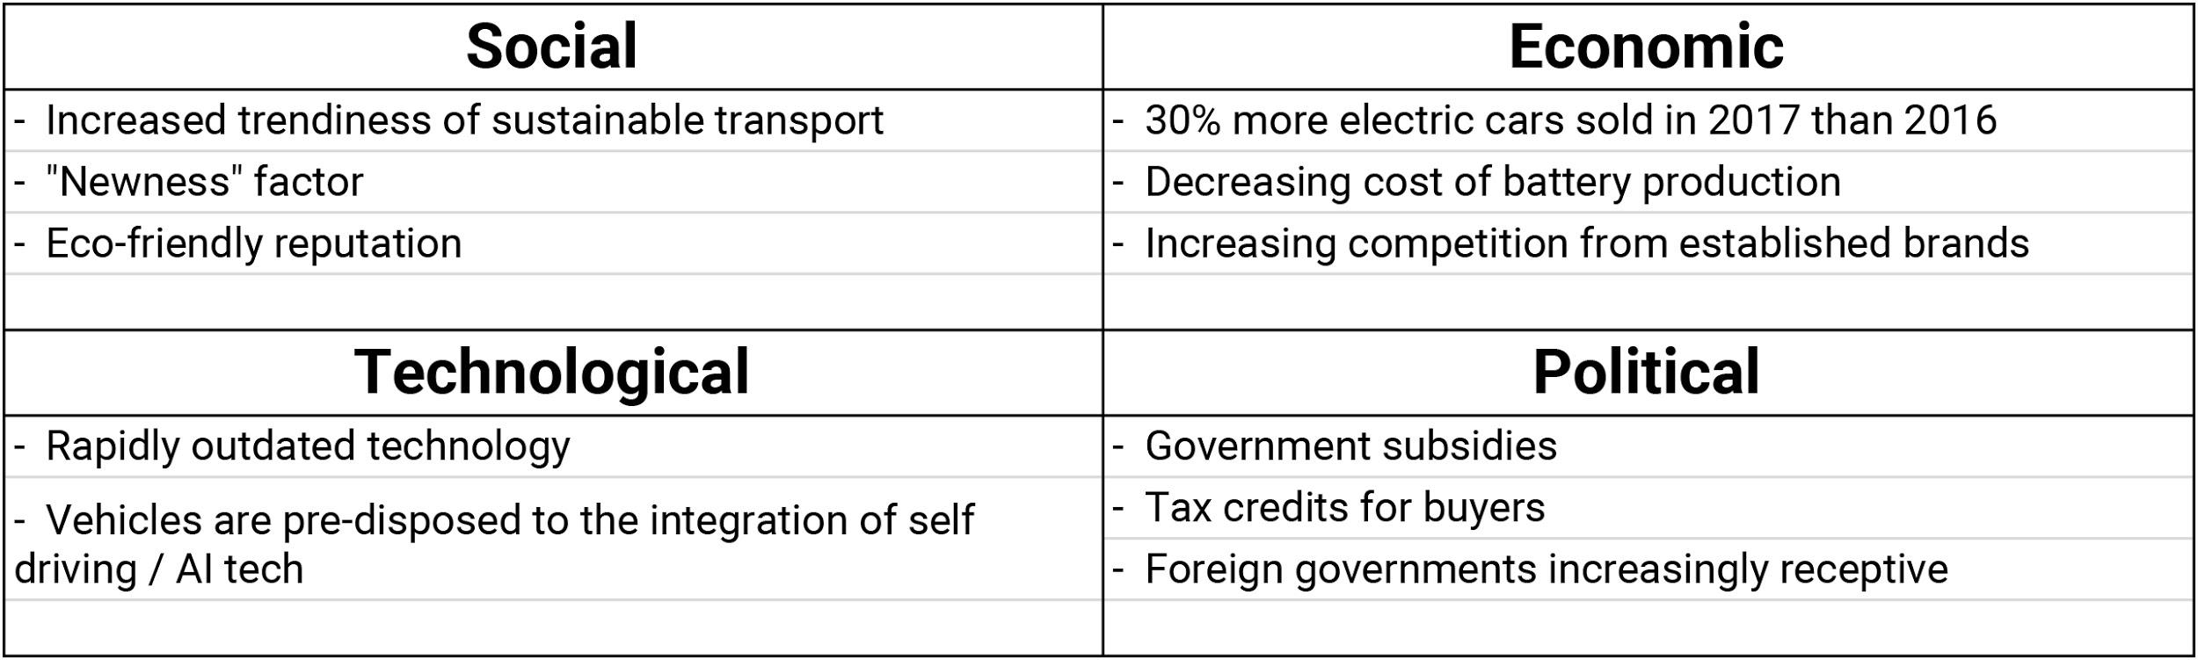
STEP/PEST

Slide 4
Analysis -
STEP/PEST
Social
  Tesla ownership is a positive thing
  In certain sectors, such as the technology industry, Teslas are more of an unspoken necessity for executives than traditional sedans
Technological
  Designed for AI from the get go
  Patents are publicly available for free
  Supercharger network is leading the industry

Slide 5
Analysis -
STEP/PEST
Economic
  Quantity of competition has increased in the past few years
  Rapid growth of the sector
Political
  Tax incentives for both Tesla and buyers
  Foreign reception to electric cars and cars from American markets in general has improved overall

Slide 6
Bibliography
Frue, K. (2018, October 17). PESTLE Analysis of Tesla Inc.: The growth of the eco-friendly electric car. Retrieved from https://pestleanalysis.com/pestle-analysis-of-tesla/
Here's Why Tesla's Supercharging Network Will Prevail. (2019, January 01). Retrieved from https://insideevs.com/tesla-
supercharging-network-wins/
McCue, J. (2018, October 03). Mercedes-Benz Models Names Explained. Retrieved from https://www.mbhuntington.com/
mercedes-benz-model-names-explained/
PESTLEanalysis Contributor. (2016, June 20). How to Perform a PEST Analysis in 5 Easy Steps. Retrieved from https://pestleanalysis.com/perform-pest-analysis-5-easy-steps/
Pickup Trucks. (n.d.). Retrieved from https://www.green
carreports.com/news/pickups
Strategy Canvas | Blue Ocean Tools and Frameworks. (n.d.). Retrieved from https://www.blueoceanstrategy.com/
tools/strategy-canvas/
U.S. car market: By vehicle type 2018 | Statistic. (n.d.). Retrieved from https://www.statista.com/statistics/276506/change-in-us
-car-demand-by-vehicle-type/
What is a Strategy Canvas? (2017, December 15). Retrieved from https://www.intrafocus.com/2014/06/strategy-canvas/

Slide 7
Bibliography
Setting up a balanced scorecard (BSC) for managing your firm. (2018, February 20). Retrieved from https://www.cleverism.com/setting-up-balanced-scorecard-managing-firms-performance/https://www.clearpointstrategy.com/brief-balanced-scorecard-history-four-takeaways/
The Balanced Scorecard - Translating Strategy into Action. (n.d.). Retrieved from https://yaoota.com/en-ng/product/the-balanced-scorecard-translating-strategy-into-action-7-price-from-konga-nigeria
What is the Balanced Scorecard? (n.d.). Retrieved from https://www.balancedscorecard.org/BSC-Basics/About-the-Balanced-Scorecard
What is a Balanced Scorecard? A short and simple guide for 2019. (n.d.). Retrieved from https://balancedscorecards.com/balanced-scorecard/#learn-summary
Tremblay, M. (2017, April 07). Tesla Motors BSC. Retrieved from https://prezi.com/zviatnm4-6vn/tesla-motors-bsc/
Schreiber, B. A., & Gregersen, E. (2019, February 21). Tesla, Inc. Retrieved from https://www.britannica.com/topic/Tesla-Motors

